Slide 1
DAB 304 Healthcare Analytics Covid-19 Detection Using CT-Scan
Section2:Group 13 Karthick Raja Radhakrishnan:0769173 Saheli Konde:0769625 Nikhita Garlapati: 0775990

Slide 2
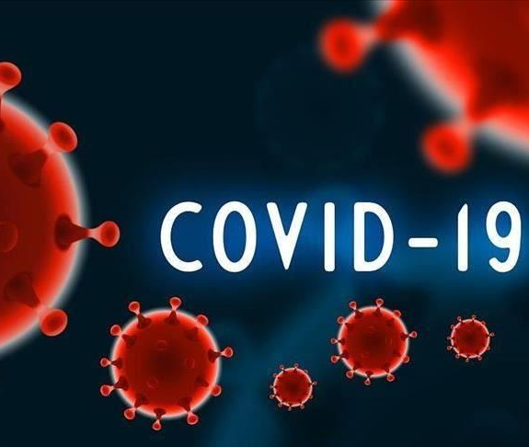
Content
Introduction
Problem Statement
Dataset
Data cleaning
Pre-processing
Model Creation & Evaluation
Transfer Learning
Results & Conclusion
Challenges

Slide 3
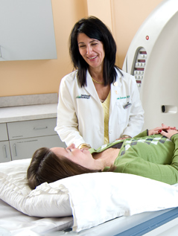
Introduction
The World Health Organization declared COVID-19 as a global emergency after the outbreak in December 2019. Diagnosis and prognosis of this disease are important as well as necessary to help patients and the health care system. Currently, RT-PCR tests are being used to detect the COVID-19 but there are a lot of false-negative test results despite its advantages. There is another diagnostic method to detect the COVID-19 which is using CT images. Lung CT images can be used to detect characteristic abnormalities associated with COVID-19.

Slide 4

Problem statement
Currently, RT-PCR tests are being used to detect the COVID-19 but there are a lot of false-negative test results despite its advantages. There is another diagnostic method to detect the COVID-19 which is using CT images. Lung CT images can be used to detect characteristic abnormalities associated with COVID-19.

Slide 5
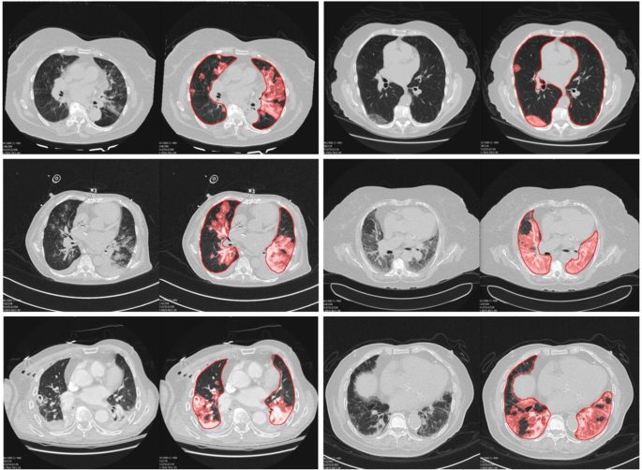
Dataset
Our dataset consists of 17104 images in which we had three categories of CT scan images with covid-19, non covid-19 and pneumonia.
Category | Count
Covid-19 | 7593
Non-covid-19 | 6893
pneumonia | 2618

Slide 6
Data cleaning
In data cleaning we removed corrupted images.
Check the image format and convert into png format.

Slide 7
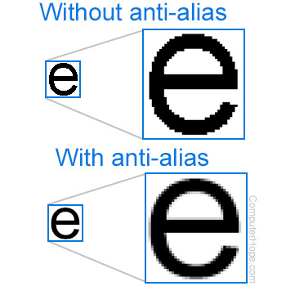
Image pre-processing
Image Rescaling : 256*256 pixels
Anti-Aliasing

Slide 8
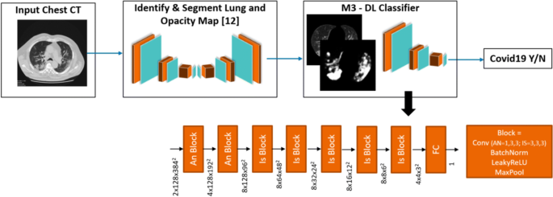
Methodology
Covid-19 detection using CNN

Slide 9
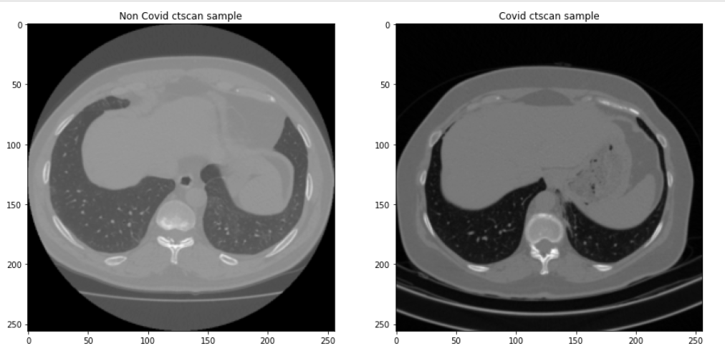
Binary class model

Slide 10
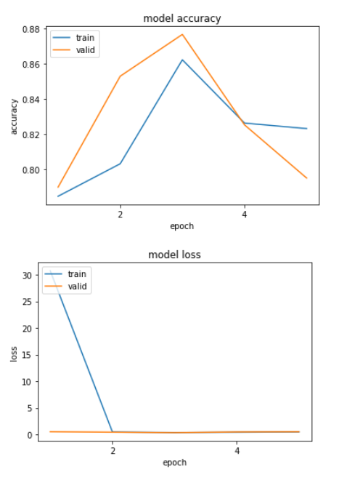
Baseline Binary model
Accuracy - 82%

Slide 11
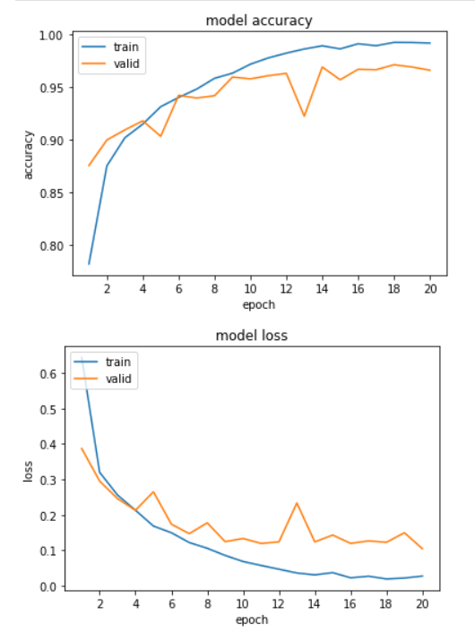
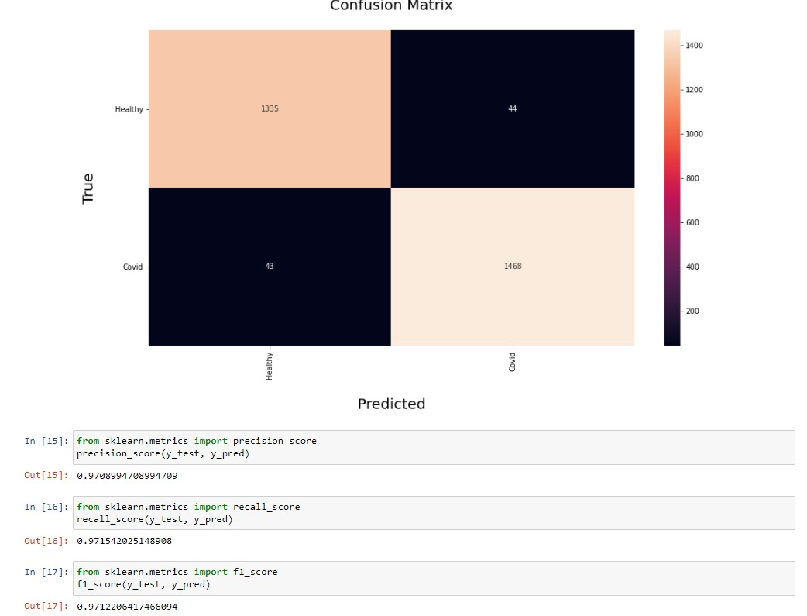
Final Binary Class model
Accuracy - 96%

Slide 12
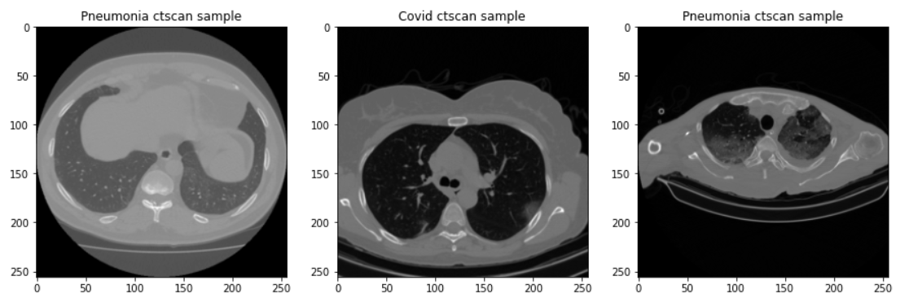
Multi class model

Slide 13
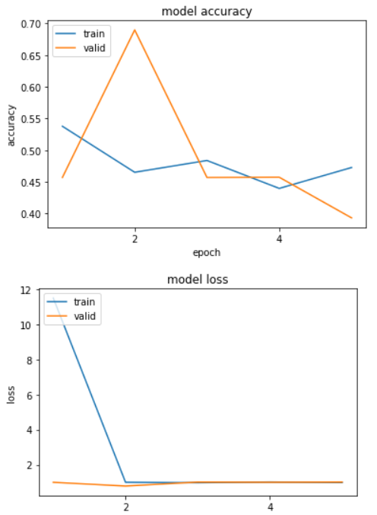
Baseline Multi-class model
Accuracy - 47%

Slide 14
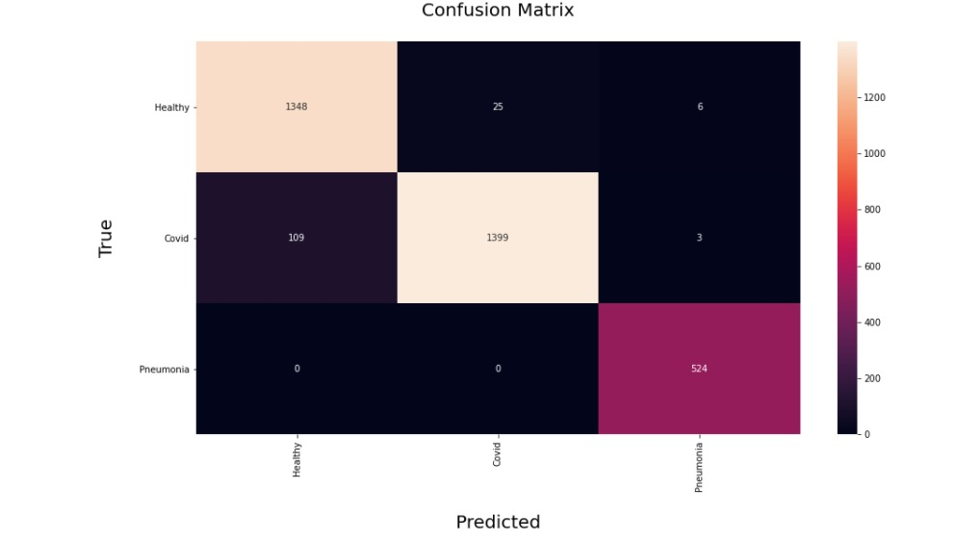
Final Multi Class model
Accuracy -96%

Slide 15
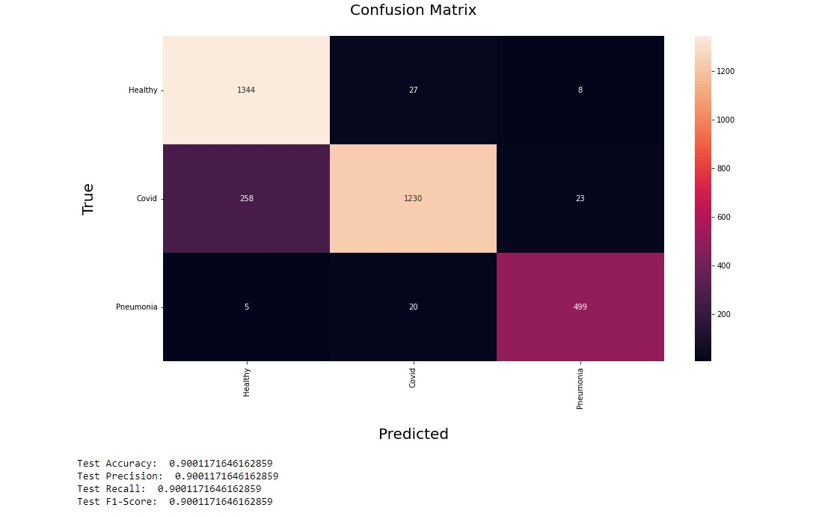
Transfer Learning – DenseNet121
Accuracy -90%

Slide 16
Result & Conclusion
Binary Class Model | Accuracy
Baseline Model | 82%
Updated Model | 96%
Multi Class Model | Accuracy
Baseline Model | 47%
Updated Model | 96%
Transfer Learning Multi Class Model | Accuracy
DenseNet121 | 90%

Slide 17
Challenges
The main challenge is processing the large volume of images.
It is difficult to store the real time images, as the volume of images increases rapidly.
We researched on many articles and also finding more images is difficult task.
In real time we need radiologist to label the ct-scan images.
It is difficult to obtain high accuracy with limited amount of data.

Slide 18

Reference
Deep learning for COVID-19 detection based on CT images | Scientific Reports (nature.com)
https://www.sciencedirect.com/science/article/pii/S1746809421005176
https://link.springer.com/article/10.1007/s00330-021-07937-3
Maftouni, M., Law, A.C, Shen, B., Zhou, Y., Yazdi, N., and Kong, Z.J. “A Robust Ensemble-Deep Learning Model for COVID-19 Diagnosis based on an Integrated CT Scan Images Database,” Proceedings of the 2021 Industrial and Systems Engineering Conference, Virtual Conference, May 22-25, 2021.

Slide 19
Future Scope
Model improvement
Real Time image
Images with pre-labelled

Slide 20
Thank You

